Slide 1
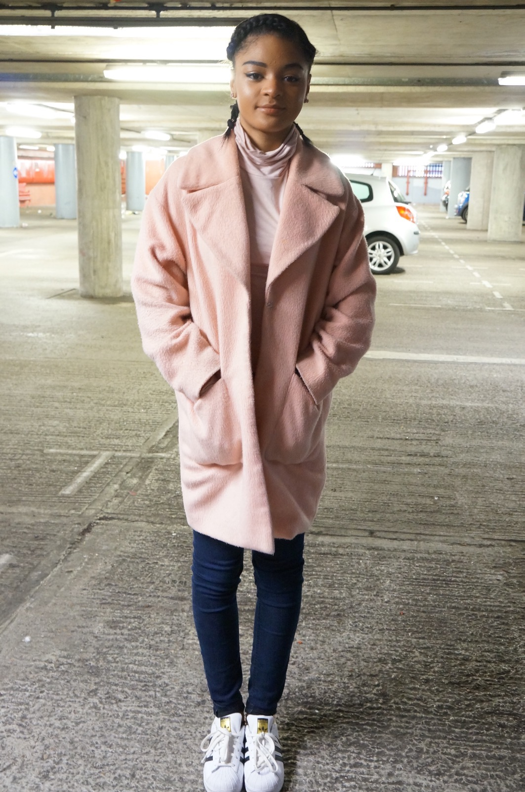
COSTUME DESIGN #1
What costumes are you going to use in your opening sequence?
Analyse and annotate the costumes you will be using – what is its representation / connotations?
In the opening of my movie, the costume design of each character is a crucial part of the narrative. For Lauryn, my group and I decided that her clothes should be representative of her personality. Lauryn is an introvert and is a very shy, timid person and tends to keep herself to herself. We therefore decided that her clothes should be dull, and not very exciting. We chose pastel colours which aren’t usually associated with uplifting happy people. We decided that
the pastel colours are a good representation of the dullness in her life as she has no friends and ultimately has no life consisting of social activities. We then decided that she should also wear dark blue jeans to contrast the pastel colours. The dark blue represents the darkness in her life; as she gets abused at home. The blue then represents the coldness that her life brings and the cold that she feels due to her being empty, lifeless, and lonely.

Slide 2
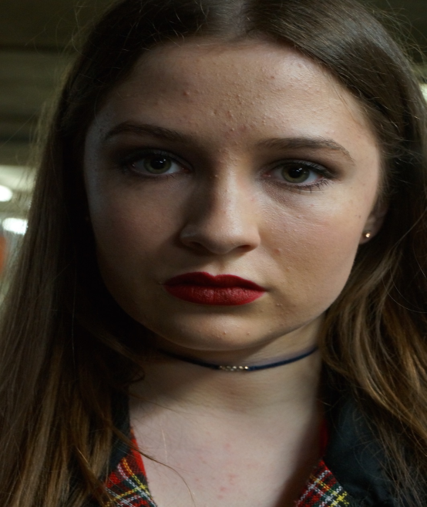
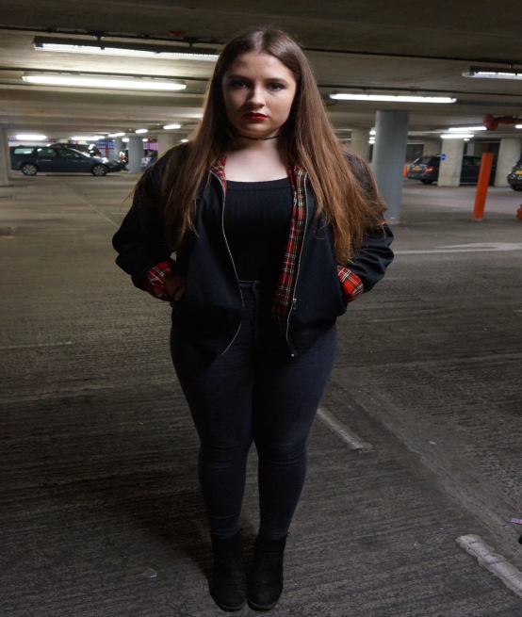
COSTUME DESIGN #2
What costumes are you going to use in your opening sequence?
Analyse and annotate the costumes you will be using – what is its representation / connotations?
In addition, the clothing choice for Scarlett was again, representative of her personality and the way we would like the audience to view her. Scarlett, similarly to Lauryn, struggles to make friends and has problems at home regarding her parents and family. These problems in turn make her a malicious and evil person. This is then represented in her clothing and make up. First of all, the clothing that my group and I decided was a black jacket, a black top, black jeans and black heels. The black simply represents how we intend her to be seen.
Black is associated with power, death, evil, and mystery and she overpowers Lauryn, kills Lauryn due to her evil nature, all whilst being a mysterious character. Black is a mysterious colour associated with fear and the unknown and this is a key component of the horror genre. Lastly, we also chose dark makeup consisting of red lipstick and dark black eyes. The red lipstick also connotes danger, blood-death, and implies that she’s a danger within the movie. The black then connotes all my previous points and just reinforces the fact that’s she’s a mysterious character in the movie.

