Slide 1
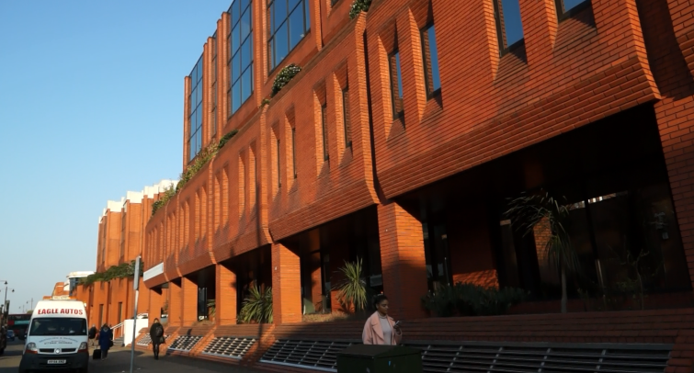
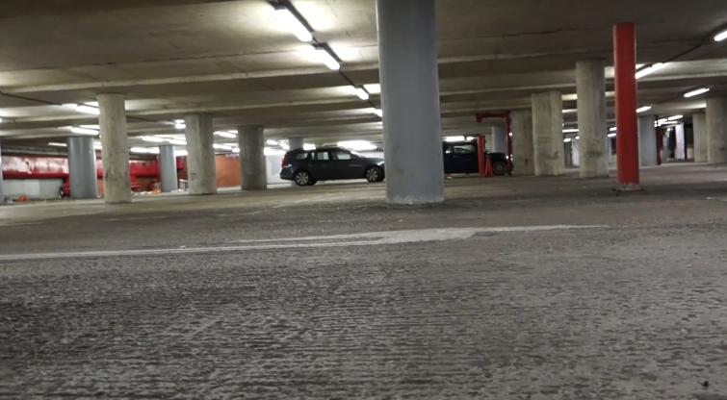
LOCATION SCOUTING
X
LOCATION ONE:
LOCATION TWO:
X
How does this location aid your narrative or character development?
How does this location aid your narrative or character development?
This location aids the narrative and character development as the entrance to the car park is outside in the broad daylight. This could therefore indicate to the audience that the daylight is associated with Lauryn, and could present her as the protagonist who is all good, cordial and is the better one out of the two friends. As Lauryn then descends into the car park down the ramp, the lighting begins to fade and then turns into slight darkness, and that can then be associated with Scarlett as that is the place where she is found and therefore connotes that she is bad, dangerous and mysterious.
This location aids the narrative and character development as the car park is dark and dingy, and darkness connotes danger, evil, despair and pain. This then allows the audience to gather more of an understanding about the narrative as they can then understand that by Lauryn entering the car park, she may be faced with something that leads her into danger, pain and despair caused by the evil character, Scarlett. In the car park, there are lights, however only illuminated when Lauryn walks past which reinforces her good nature as a character and reinforces that in the absence of light there is danger cause by Scarlett.
How does this location match the genre conventions?
How does this location match the genre conventions?
This location matches the genre conventions as when Lauryn goes down the ramp, you can see darkness and that connotes badness which is matched with the horror convention.
This location matches the genre conventions as darkness is a main feature in the horror genre. The connotations of darkness then reinforces how it matches to the genre conventions as danger and evil are associated with the horror genre.

