Slide 1
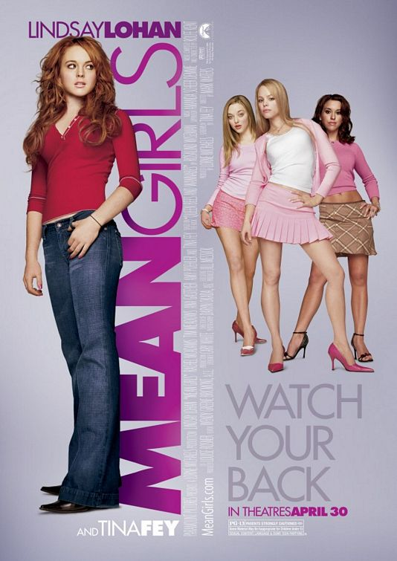
Mean Girls
Mise-En-Scene/Audience Genre/ideology:
The colouring of the poster itself immediately reflects the type of audience the picture is trying to appeal to. The mixture of pinks purples stereotypically appeal to the teenage/young adult female audience, this audience is the further drawn in by the recognisable face and name of ‘Lindsay Lohan’. It also can appeal to the more middle aged adult, this audience is then drawn in further by the name of ‘Tina Fey’ located at the bottom of the poster.
Tagline:
‘Watch your back’ – This emphasises the fact that the girls are mean and are most likely to start arguments and fights, hence the fact people need to watch their backs. This draws the audience to watch the movie as they know it’ll be funny and full of action.
Studio logo:
Through being released by ‘Paramount pictures’ it immediately indicates that this movie is of a high budget. The employment of famous and successful actors along with the advertisement for the films website also indicate that this film is of a high budget, and encourages the audience to research more about it.
Character Imagery:
The almost ‘sexualised’ positions if the three characters in the poster further indicates a more stereotypical and idealistic representation of women. The indicates that the audience must appeal to women.

